Slide 1
Video Communication and Virtual Collaboration Platform

Slide 2
1. Project Overview & Objectives
Secure Communication
MFA Security
Collaborative Workspaces
Demonstration MFA flow at login (mock verification) to validate enterprise authentication patterns.
WebRTC-based rooms with passcodes, waiting rooms, and transport-level controls to protect session integrity.
Persistent whiteboards, shared markdown notes, chat threads, polls, and Q&A inside each meeting.
AI-assisted Analytics
Recording Vault
Enterprise Control
Live transcription, translation, searchable summaries, and automated action-item extraction.
Browser MediaRecorder captures sessions with interactive transcripts that jump to timestamps.
Custom SVG charts for usage, license allocation, and audit-log analysis.

Slide 3
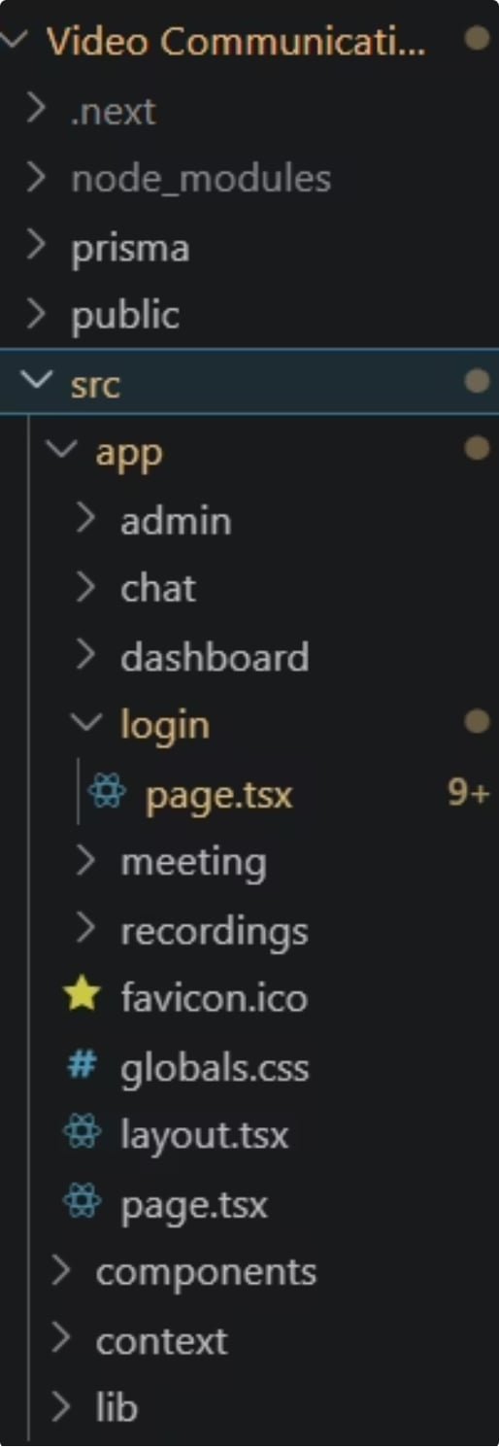
2. Folder Structure & Purpose
Root — project metadata and build config (package.json, tsconfig, next.config).
prisma/ — schema.prisma defines relational models and local SQLite engine (prisma/dev.db).
public/ — static assets: logos, SVGs, icons used across the app.
src/app/ — Next.js App Router pages and API routes; key routes: admin, chat, dashboard, login, meeting/[id], recordings.
src/components/ — reusable widgets: Sidebar, Whiteboard, Notes, ChatPanel, PollsPanel, QAPanel, AIAssistant, AdminCharts.
src/context/ — AppContext manages sessions, user roles, and global state.
src/lib/ — prisma.ts exports the initialized Prisma client for server-side data access.

Slide 4
3. Step-by-Step Local Runbook
Follow this concise runbook to reproduce the app locally. Each command runs from the project root.
1
Step 1 — Open Terminal
cd "C:\\Users\\ravik\\OneDrive\\Desktop\\VC2\\Video Communication Platform"
2
Step 2 — Install Dependencies
npm install — installs next, react, prisma, tailwind, and other dependencies declared in package.json.
3
Step 3 — Initialize Database
npx prisma generate
npx prisma db push — generates client and pushes schema to local SQLite (prisma/dev.db).
4
Step 4 — Start Dev Server
npm run dev — boots the Next.js development server and hot-reloads routes.
5
Step 5 — Open App
Open http://localhost:3000 in a modern browser (Chrome/Edge/Firefox/Safari with WebRTC support).
Tip: For PostgreSQL, update prisma/schema.prisma datasource and add DATABASE_URL to .env before running prisma generate & db push.

Slide 5
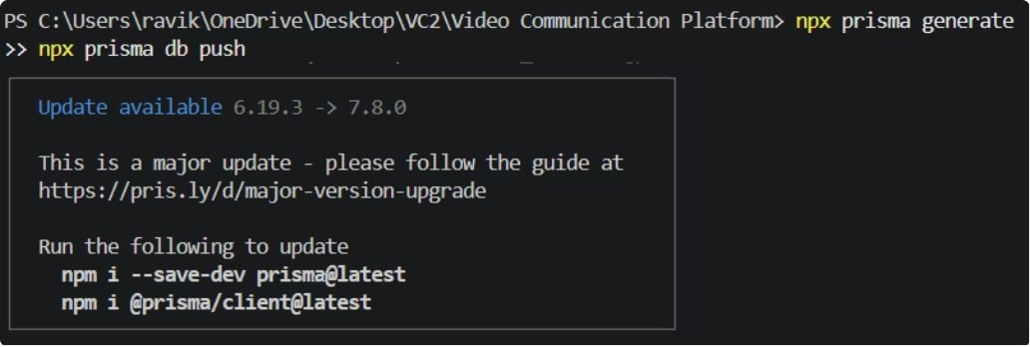
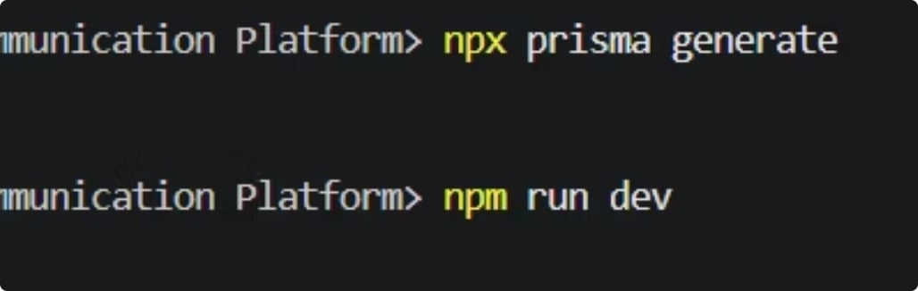
4 Step by Step Running Steps
Initialize Database
Start Dev Server

Slide 6
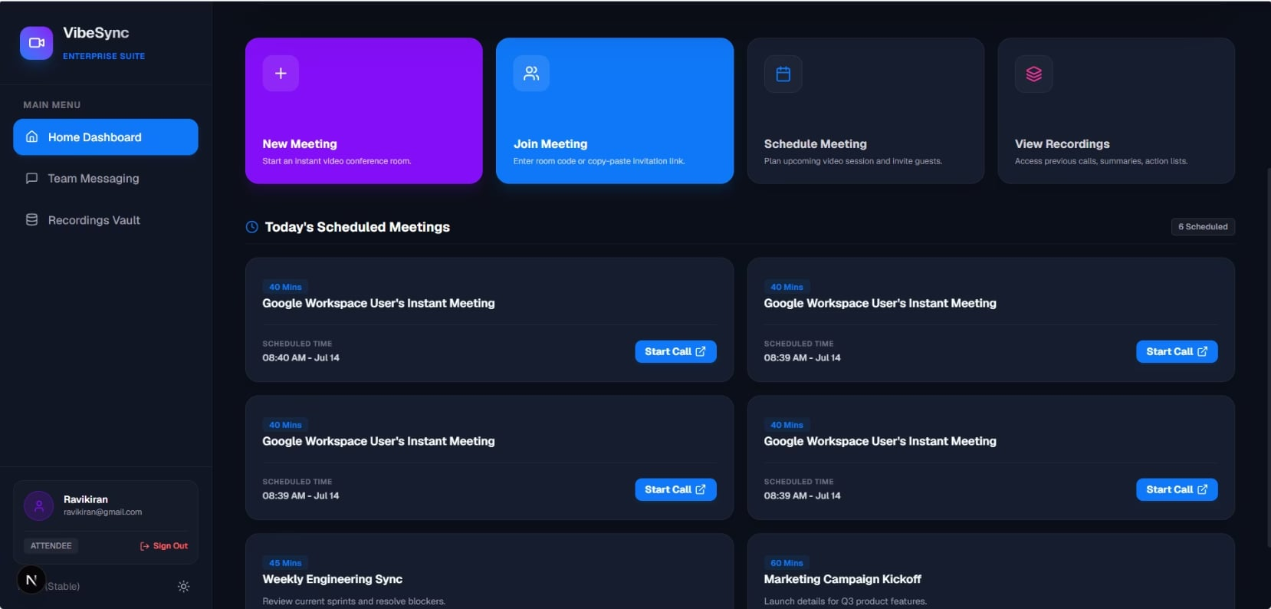
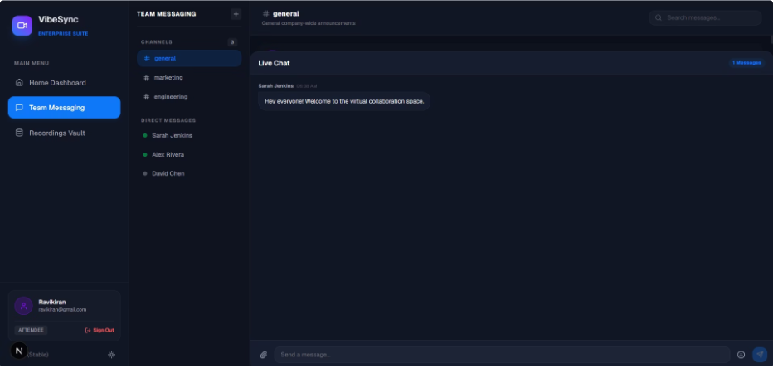
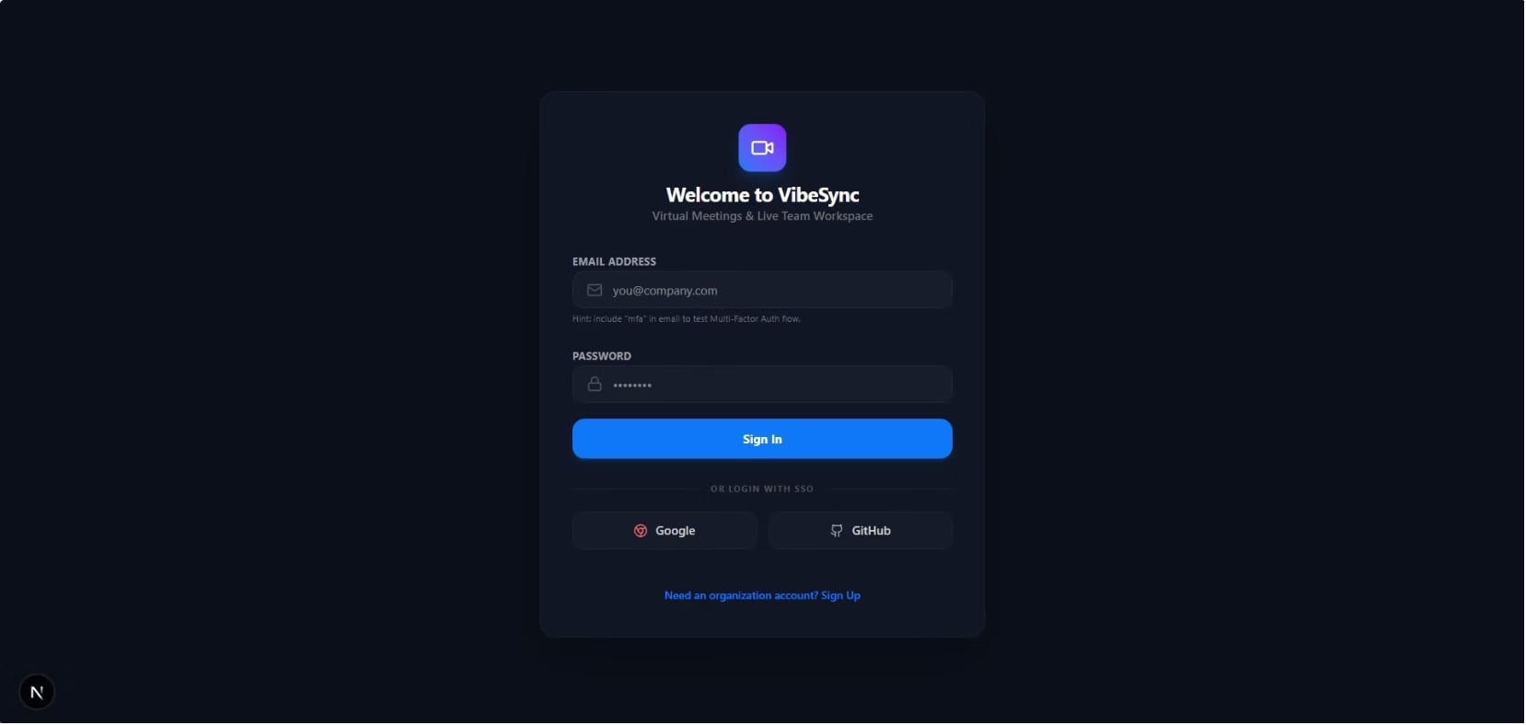
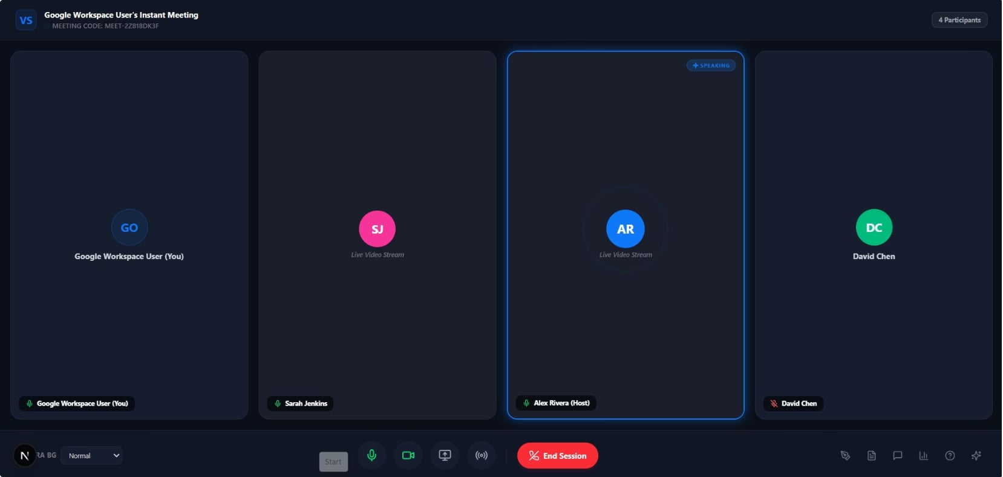
5. Execution Process & Output Screenshots (MANDATORY)

Slide 7

6. Required Software, Dependencies & Additional Notes
Runtime
Key Packages (from package.json)
Node.js v18+ (LTS recommended).
next v16.2.10 — App Router and server rendering
react / react-dom v19.2.4 — UI framework
prisma / @prisma/client v6.2.1 — schema and query client
tailwindcss v4 — utility-first styling
Package Manager
NPM (bundled with Node). Use npm ci for consistent installs in CI.
Testing MFA: use an email containing "mfa" to trigger mock passcode flow. Use code 123456 to pass verification.
Browser
Chrome/Edge/Firefox/Safari with WebRTC & getUserMedia support.

